Slide 1
Bellisario College of Communications
Graduate Student
Travel Reimbursement Process
Updated: March 13, 2023

Slide 2
Available Funds:
Students can generally expect the following maximum disbursements; these totals, of course, are subject to budgetary changes/constraints in the College and are re-evaluated annually:
1st -year Ph.D.: $500
2nd -year Ph.D.: $900
3rd-year Ph.D. students: $1000
4th-year Ph.D. students: $1100
2nd year MA students on assistantships: $600
Letitia and Lea Ann can provide your available funds.
With Dean’s approval, funding that is unused in a fiscal year is eligible to carry forward to the next fiscal year.
A student’s expenses should not exceed the total amount of funding (PhD = $3,500) that is given across the 1st, 2nd, 3rd, and 4th years.
NOTE: Funding is not able to be used from future years.
EXAMPLE.- 3rd year student may not use 4th year funds.

Slide 3
Graduate Funding Request:
All students will be required to submit a Graduate Funding Request form for conference/travel BEFORE attending an event.

Slide 4
Reimbursement Procedures
To receive the total amount of funding requested, all detailed receipts must be submitted with a completed
Travel Reimbursement Checklist - CONUS Or Travel Reimbursement Checklist - OCONUS
Submit COMPLETED checklist and all ITEMIZED receipts within five business days of the conference's end.
**If this is not possible, please contact the Coordinator of Graduate Programs. Reimbursements will be processed first received first completed.
CONUS/OCONUS:
The continental U.S., or CONUS, is the 48 connected states and District of Columbia. OCONUS is outside the continental U.S.

Slide 5
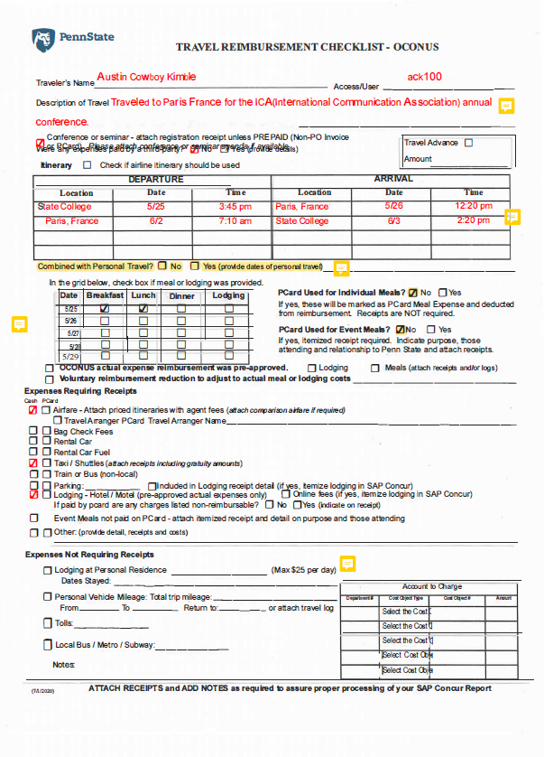
What is a completed Travel Reimbursement Checklist?
Itinerary must have departure and arrival days and time for each leg.
You do not need to put each layover for your flights. Only where you began and your final arrival location.
Why did you travel? Please add this in the description.
Is there any portion or days there were only personal travel?
Meals? Are you asking for per diem? If so we need to know if any meals were provided.
Is there any portion or days there were only personal travel?
Are there any other expenses you are requesting to be reimbursed for? If so, we need itemized receipts.

Slide 6
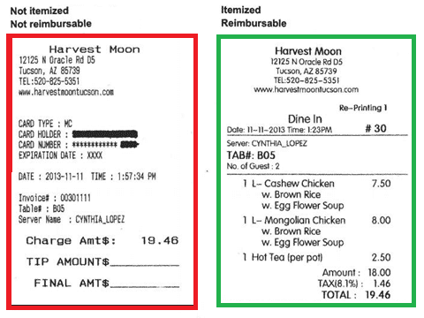
What is an itemized receipt?
An itemized receipt needs to include several key pieces of information:
Name of the business
Business’s address and phone number
Receipt number
Date of service
Price of each purchased item
Taxes, fees, and discounts
Method of payment

Slide 7

Receipt submission should include:
WHO: Who is this purchase/travel for
WHAT: What is the nature of the (these) business expense(s)
WHEN: When did the business expense(s) take place (Date and Time)
WHERE: Where did the business expense(s) take place (Name of Vendor, Location)
WHY: Please explain, in detail, the business purpose of the expense(s)
*Please do not use abbreviations or acronyms when providing the above details – when acronyms are used, please spell out what it represents.
**Provide all the details of the travel even if you are not asking for reimbursement.

Slide 8

Airfare:
Anthony Travel through SAP Concur is required to book airfare.
The link is: Penn State SAP Concur
If you decide to include:
personal travel
take an alternate route that is either longer than the conference
depart or arrive from an airport that is not University Park
An airfare comparison MUST be provided. It is required to be the lowest fare for 1 day before to 1 day after the conference/or convention.
**If cost of the comparison flight is less than the flight selected, the traveler is responsible for the difference.

Slide 9

Driving:
If traveling by car, the start location and venue must be included in the report.
Mileage will be calculated electronically by the system. If additional stops are taken, the locations of these stops must be included.
The University will reimburse for mileage, not gas. The current rate is 62.5 cents per mile.
For those who carpool, the graduate student whose vehicle is being used will be reimbursed (the amount per student will be divided among those who are carpooling).
The choice of flying versus driving is influenced by distance, time, cost, and one's preference. When flying is the economical choice, but one chooses to drive and the round-trip mileage is 750 miles or more, the reimbursement may not exceed the cost of the lowest available air transport for the same points of origin and destination.
The traveler must provide appropriate price quotes from either Travel OnLion or an acceptable travel agency, obtained at the time of the decision to drive vs. fly, to document the appropriate airfare for comparison.
Notes:
Preapproval to drive vs fly for trips over 750 miles must be requested when you submit your graduate funding request. Final decision to approve for payment will be provided by the Associate Dean for Graduate Programs.

Slide 10


Lodging:
Hotel lodging and taxes are reimbursed only. (Internet connection, phone calls or room service – even if on the receipt -- will not be covered.)
Must include itemized lodging expense. Credit card receipts are NOT acceptable.
If sharing a room, it is recommended that individual receipts are secured for each person. If this is not possible, list the names of the people sharing the room on the receipt and the amount each person paid. If one person paid the entire bill, confirmation will be needed from the other students. International lodging will be reimbursed per diem.
Airbnb's are allowed. Follow the same procedure as above for reimbursement.

Slide 11
Required Information:
Invitation to present.
Detailed conference registration with amount paid.
Membership if required for reduced conference registration.
Any additional pertinent travel details.
Poster Costs
The College will pay for the printing of the poster for conference presentations. Students making poster presentations must contact the Graduate Office on how to print the poster.

Slide 12
International Travel Policy:
All students traveling for University purposes or with University funding must record international travel in the TSN database prior to departure as outlined in the University's International Travel Requirements Policy. This includes travel for international research, conferences, and internships.
Complete a new travel record for each of your university-affiliated international trips at least 30 days (about 4 and a half weeks) before you depart. For each travel record, the TSN system will identify which forms you need to complete. Once you have completed all the web-based forms in the TSN system for your travel record and attended an Emergency Preparedness Workshop (if applicable), your record will be reviewed for completeness, and you will receive a TSN confirmation email. The review process may take up to a few weeks before you receive your final confirmation.
International travel reimbursement will not be approved without a receipt the TSN confirmation.
https://global.psu.edu/article/travel-safety-network-tsn

Slide 13
Reimbursement:
Expenses incurred before travel may be reimbursed before the travel.
These expenses can include:
  Conference Registration
  Memberships
  Airfare
**If the trip is not taken the funds that were pre-paid must be returned to the college.
Process:
Expenses are entered into the SAP system by the Bellisario Administrative team.
Graduate student submits the request through SAP Concur.
Penn State user ID and password required to log into the system.
Budget Assistant approves.
Assistant to the Financial Officer approves.
Financial Officer approves.
Accounting Office approves.
Note: Reconciliation can take several days to several weeks after submission for the reimbursement to be deposited into the student’s bank account.

Slide 14
How to submit an SAP Expense Report

Slide 15
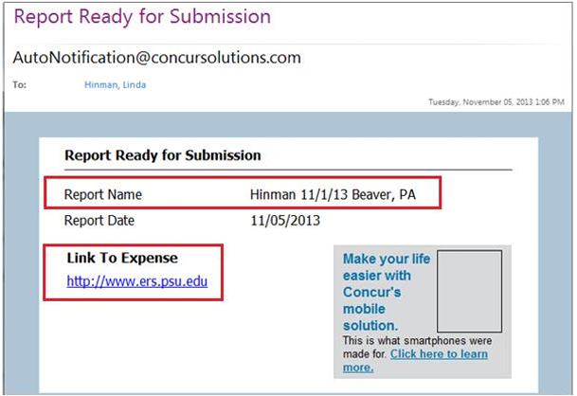
Automatic Email Notification:
You will receive an e-mail from AutoNotification@concursolutions.com with the subject
“Report Ready for Submission”.
The email will have the name of the report that is ready for submission.
Click on the Link to Expense URL in the email message.
This will open the ERS Website.

Slide 16
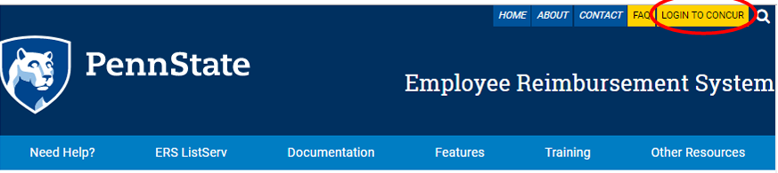
ERS-Employee Reimbursement System
At the ERS Web site, click the Log In button. Highlighted below.
Use your PSU Web Access User ID and password to enter.

Slide 17
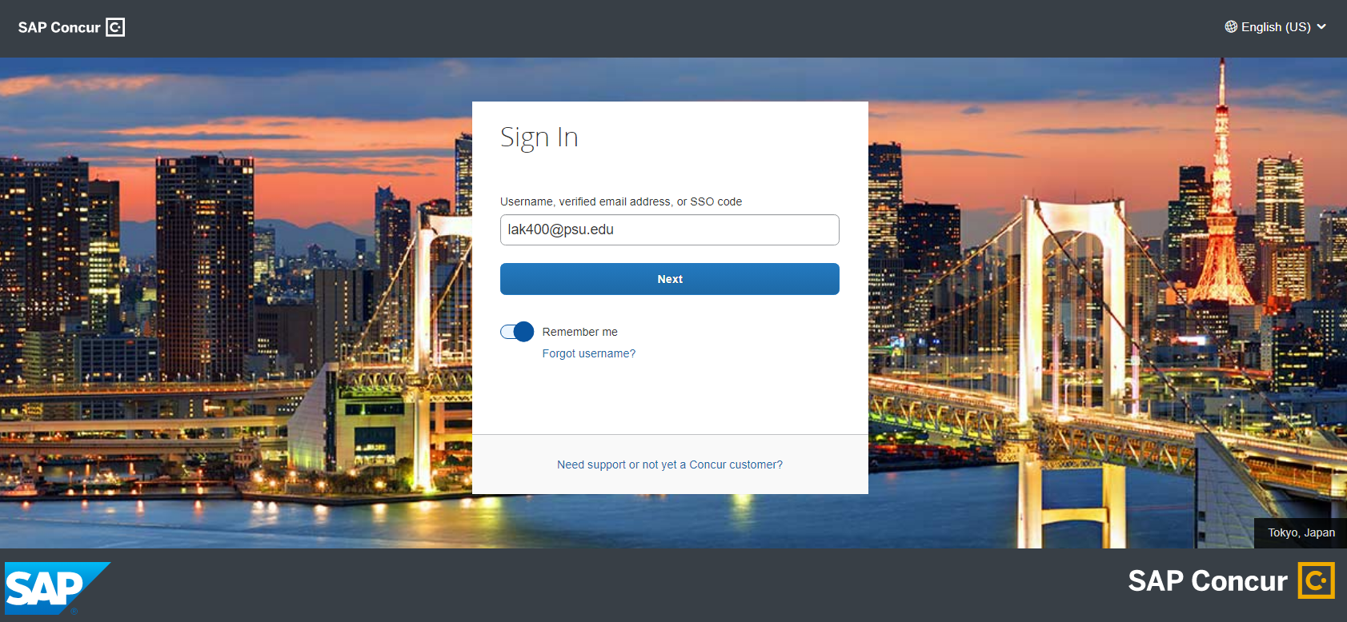
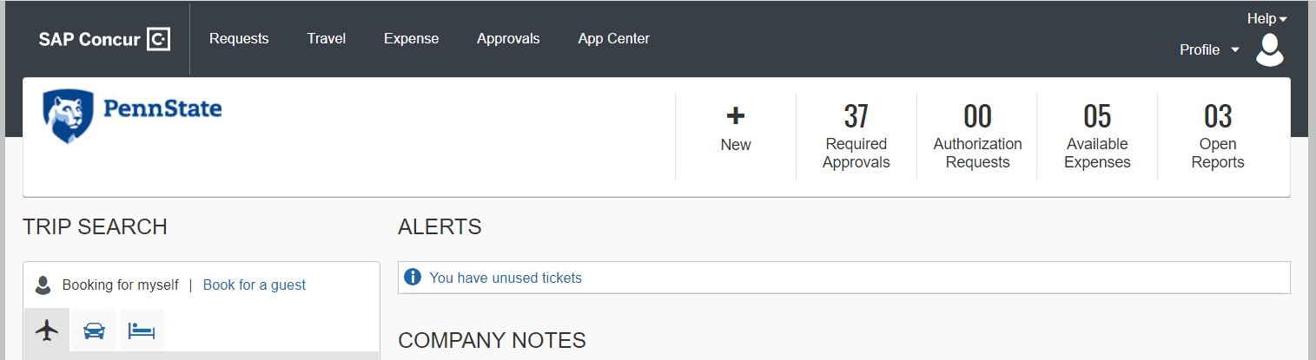
The log in page will
Look like this
The landing page will
Look like this

Slide 18
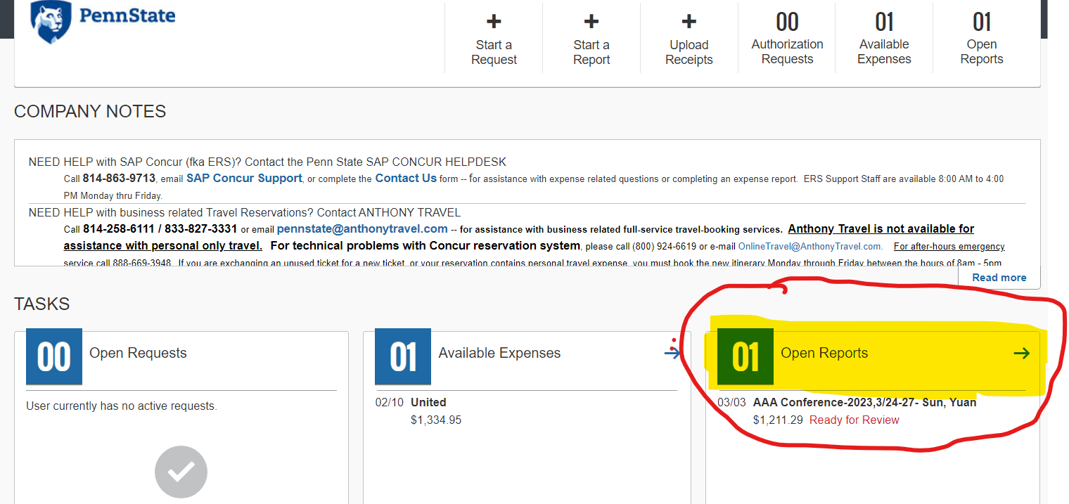
In Open Reports click on the report name that is marked Ready for Review:

Slide 19
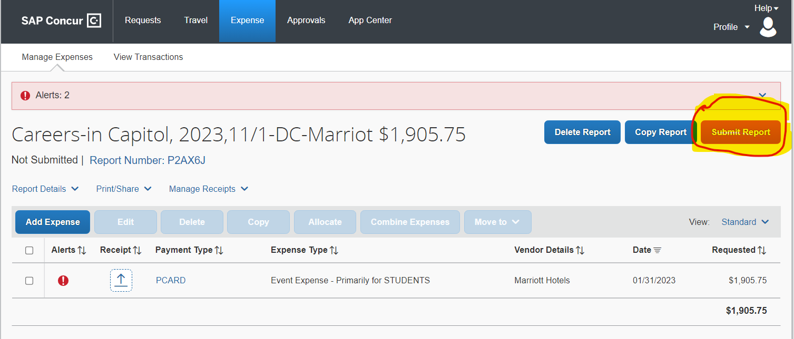
Check the report for accuracy!
It is your responsibility to check the report for accuracy before submitting.
When you are satisfied with the report, click Submit Report in the upper right corner.
Notes:
By submitting the report, you are agreeing that all information in the report is accurate.
Be sure you review the details to confirm it is correct.

Slide 20
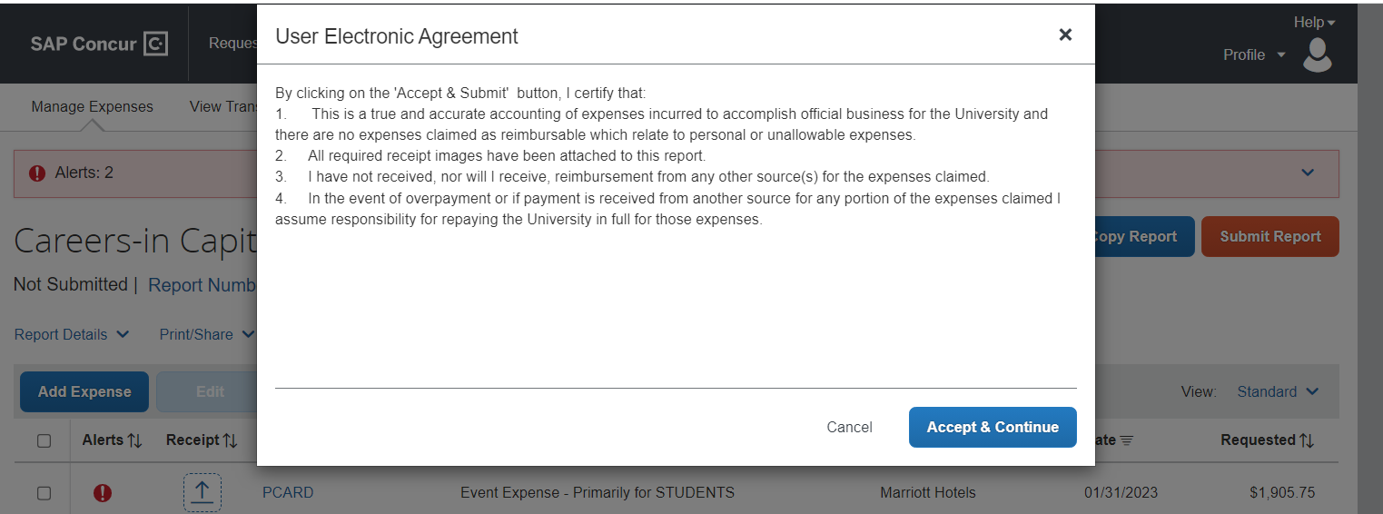
Click Accept & Submit.
By submitting the report this is your electronic signature confirming accuracy of the expense report.

Slide 21
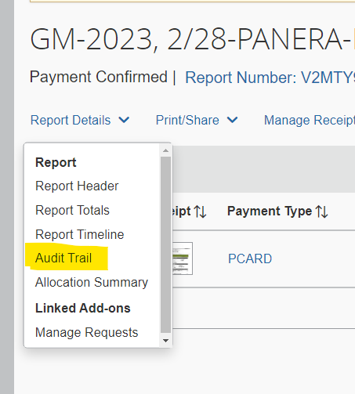
How to tell where your report is in the approval process:
Select the down arrow in the Report Details.
Select the Audit Trail.

Slide 22
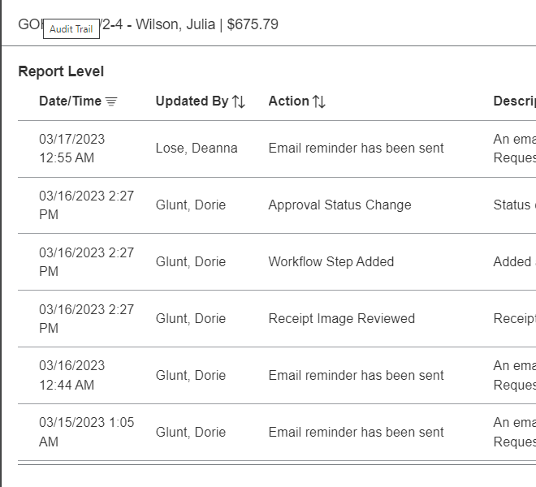
This shows you the approval flow of the report

Slide 23
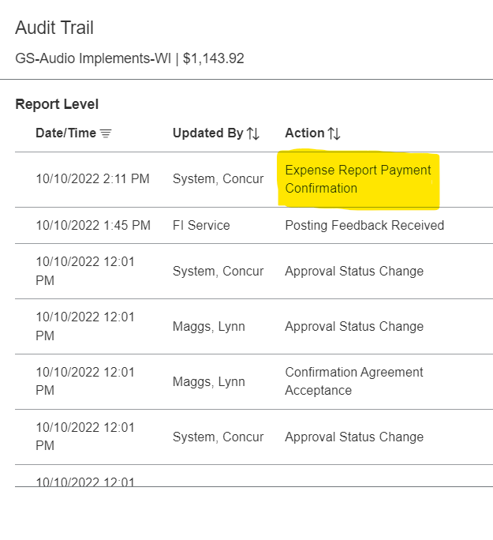
When paid you will see the payment confirmation.

Slide 24
Questions?

