Slide 1

Developing ai guidelines for your courses
Larkin Hood & Chas Brua, Schreyer Institute for Teaching Excellence

Slide 2
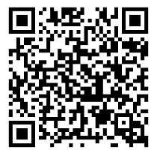
Please give us your feedback

Slide 3
The goals for today’s discussion
1. Articulate your rationale related to AI use in your own courses
2. Discuss potential differences in AI policies between individual courses
3. Reflect on how you will communicate your course AI policies to your students
C

Slide 4
Poll: Describe your experience with generative AI
Hold up the number of fingers that corresponds to your answer:
1. No experience yet
2. I’ve tried AI a little
3. I’ve used AI a lot
If you answered “1” or “2,” consider exploring with Microsoft Copilot via your Penn State account: https://psu.instructure.com/courses/2356852
C
Notes:
Get Started
Visit copilot.microsoft.com (Copilot is designed for use in Microsoft Edge but also supports other major browsers, including Chrome, Firefox, and Safari, in both desktop and mobile formats)
Select “sign in with a work or school account” under the Sign in icon in the upper right corner of the page
Log in with your Penn State userID and password, and authenticate with MFA when prompted
Verify you are using the secured version of Copilot by checking for the green “Protected” icon in the upper-right corner. This indicates the commercial data protection is enabled for your session.

Slide 5
Decision 1: articulate your own rationale
L

Slide 6
What do your students need to learn with, without, or about AI tools?
What tasks in your discipline are AI tools good at?
Are there some tasks AI tools cannot or should not do in your discipline?
Is there anything students need to learn about AI tools within the context of your specific discipline and course?
L

Slide 7
Find out how effective the tools are by trying them yourself
Prompt libraries
Your course assignments
L
Notes:
https://docs.anthropic.com/en/prompt-library/library
https://www.aiforeducation.io/prompt-library

Slide 8
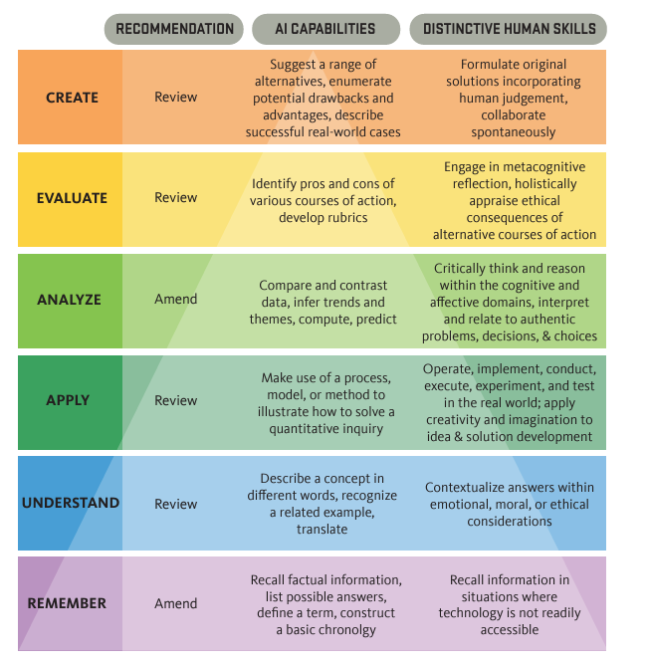
think about your course policy by reviewing a key assignment: What tasks draw on distinctly human skills? What tasks align with AI capabilities?
L
Notes:
Add to tools and resources

Slide 9

Two Lanes: Designing AI out of or into Assignments
OUT
Are there components of my assignments where using AI tools would defeat learning objectives?
Are there tasks at which AI tools excel, but my students need to learn how to do independently (Why?)
IN
How might interaction with AI tools benefit student learning?
How might the use of AI tools open opportunities for assignments that demand more higher order thinking?
L

Slide 10
Designing AI out of an Assignment
Articulate
purpose & value
rationale for designing AI out
Identify
clear learning outcomes
assignment process (tasks) and product
Experiment with prompts to understand what AI is capable of
Determine how you will assess student work and provide feedback
L

Slide 11
Designing an Assignment for Human-AI Interaction
Identify
which parts require distinctly human skills or knowledge
which skills/tasks AI is good at, but students need to do themselves & why
Determine
If students need to learn more about how to use AI tools for the assignment
How much of the assignment should focus on the process of creating output
If successful completion of the assignment requires developing output evaluation skills

Slide 12
Decision 2: How much should policies vary?
Between two versions of the same course?
Between a lower-level and an upper-level course?
Between courses for majors and non-majors?
Between content and method-oriented courses?
L

Slide 13
What can program-level curricula look like?
What do we want the students in our academic program to know and be able to do with (or without) generative AI?
At what point in our academic program—that is, in what specific courses—will students learn these skills?
Does our academic program need a discipline-specific, program-level learning outcome about generative AI?
Center for Teaching Innovation, Cornell University: https://teaching.cornell.edu/programs/faculty-instructors/curriculum-mapping-support-incorporating-generative-ai-your-academic
L

Slide 14
Decision 3: How will you explain your AI policies to your students?
C
Notes:
https://commonwealthteaching.psu.edu/ai-use-guide/

Slide 15
Determine how (and why/why not) students can use GAI tools in your course
Plan how you will discuss the use of generative AI tools with your students
Ask your students how they use AI tools
https://tinyurl.com/AI-survey-example
Explain to students
When & how AI can be useful
When & why it isn’t: “What you gain if you refrain”
C
Notes:
https://tinyurl.com/Torrey-Trust-826

Slide 16
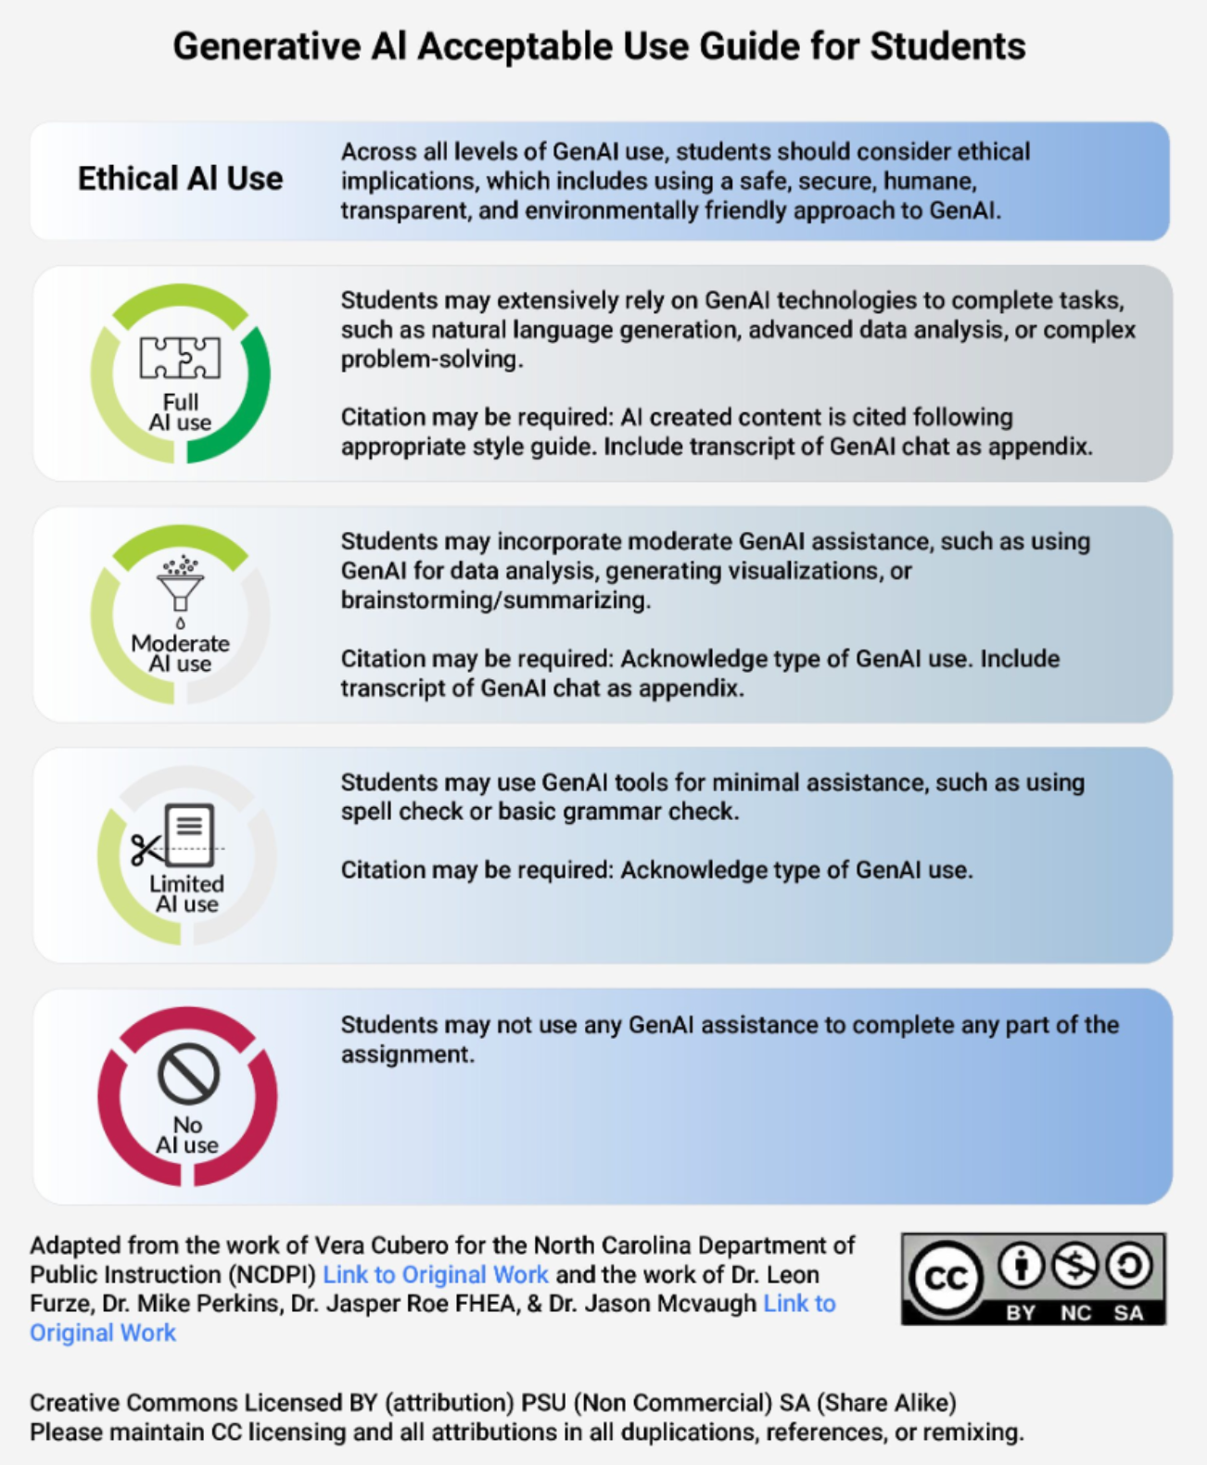
students face a varied academic landscape
Make YOUR guidelines specific
Resource: open source google document outlines a range of examples of how AI can or cannot be used
https://tinyurl.com/Torrey-Trust-826
Resource: Generative AI Acceptable Use Guide https://commonwealthteaching.psu.edu/ai-use-guide/
C
Notes:
https://commonwealthteaching.psu.edu/ai-use-guide/
Survey: https://docs.google.com/forms/d/e/1FAIpQLSfYcxeHsMDS1BBlY9RXayrgBTj_RKrqvlWEmY-_nzseM3BSwQ/viewform

Slide 17
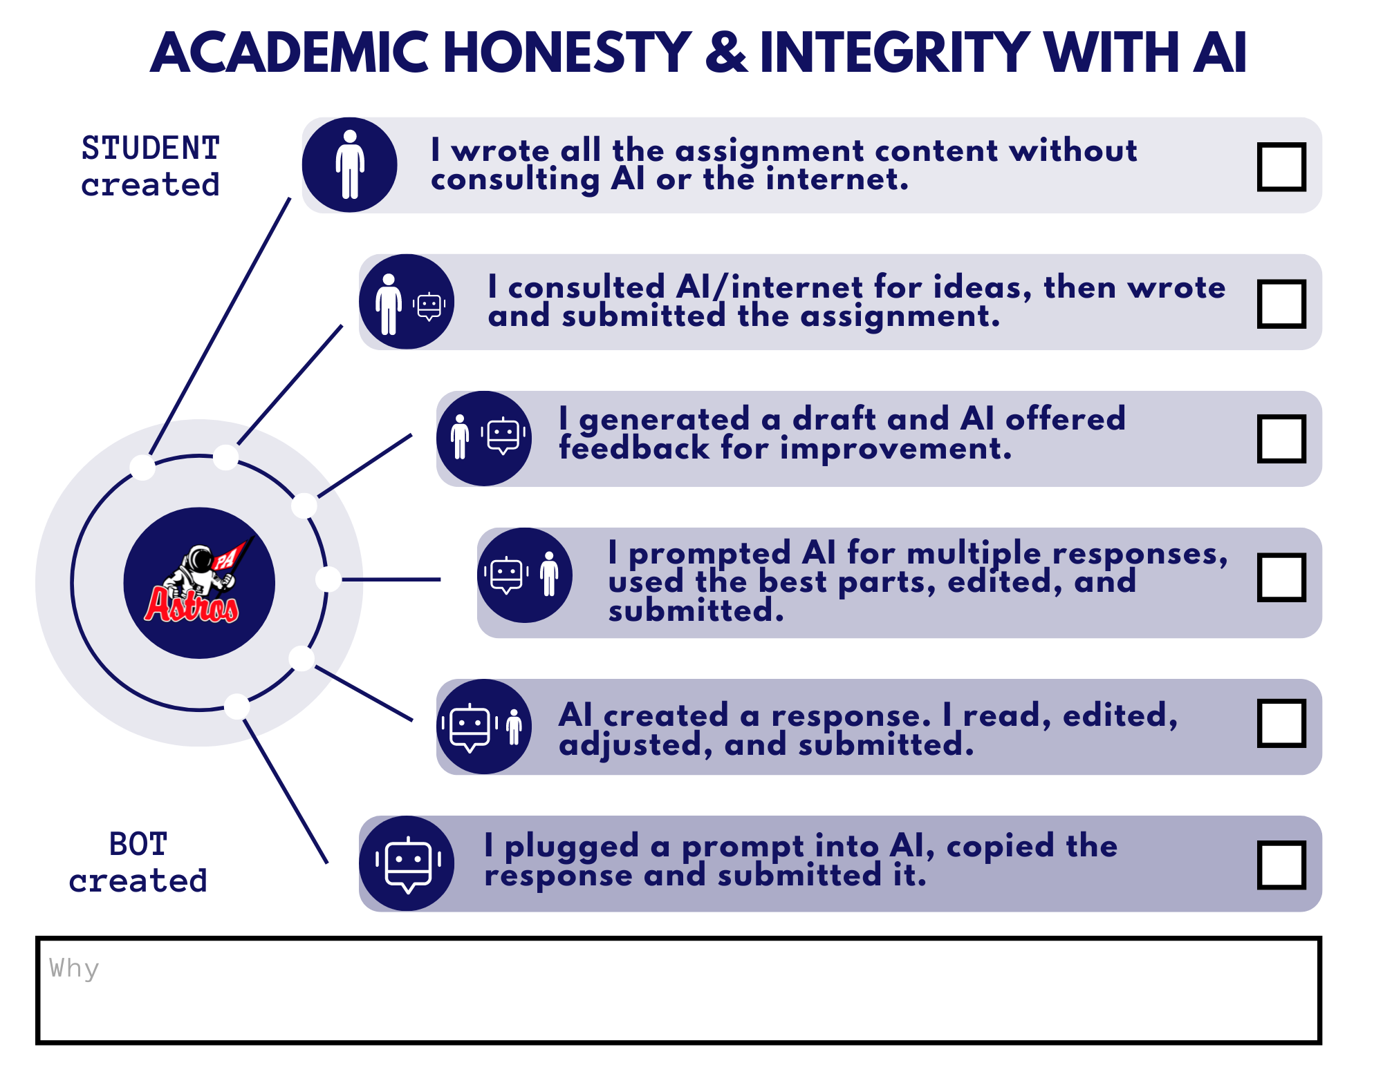
Make your guidelines specific: Another example
Christina Dimicelli
Director of Edtech Learning & Growth, Pinkerton Academy
C

Slide 18

Schreyer consultants can help
Contact
Chas Brua: crb129@psu.edu
Larkin Hood: lnh2@psu.edu
Schreyer Institute: site@psu.edu
L

Slide 19
Please give us your feedback

Slide 20







Follow Us
site@psu.edu
instagram.com/site_psu
Main page
facebook.com/SITE.PSU
linkedin.com/company/schreyer-institute-for-teaching-excellence
Graduate Instructors and TAs Page
facebook.com/PSUteach
schreyerinstitute.psu.edu
tinyurl.com/schreyervideos
L
Notes:
M A

