Slide 1
Navigating a virtual career fair
student tutorial

Slide 2
hello
Julie Miller
Manager of Internships
jlm156@psu.edu

Slide 3
intro
PREPARING FOR THE EVENT
ENTERING THE EVENT
PARTICIPATING IN THE EVENT
FAQs
TAKE THE NEXT STEP
Notes:
Agenda

Slide 4
Preparing for the Event
Create a Brazen account using your Penn State SSO
Test your compatibility and accessibility of your devices with Brazen
Register for the fair/event
Revise your resume/CV/LinkedIn/Portfolio
Review employers attending
Do your research
Prepare for your interactions
HOW CAN I BEST PREPARE?
Notes:
Contact Brazen tech support if you experience technical difficulties; Brazen Support Form: support@Brazen.com
Customize your resources based on the employer and/or job description
Upload your resume to your profile
Use job categories / booth tags functionality to search for employers within specific categories. You will only be able to do this in Brazen during the actual event.
Research: What do you want to learn? Does the organization's values match your passions? Is their culture compatible with your ideal working environment? Review their website and Glassdoor to discover benefits, location, rating, etc.
Take notes and keep an organized file on each organization that you have researched so that you can easily ask your questions during the interaction
Dress for success
Test your webcam and background; prepare for a video interaction with professional dress and background; contact your campus career office for resources and support

Slide 5
Part 1: Creating a Brazen Account
Step 1: Navigate to the Event Landing page
https://app.brazenconnect.com/a/Comm/e/4LYKm
If you have an account- click log in at the top right
If not, click "Register Now"
Notes:
Use the event URL to access our event hosted by Brazen - https://app.brazenconnect.com/a/Comm/e/4LYKm.
If you have already created an account, you can click to log in at the top right of the page. If you have not, click “Register Now”
Event Landing Pages will be accessed via links advertised to you by event managers
Students who already used Brazen with other email addresses (e.g., gmail) should be logging in to Brazen as they did previously (not through our event login) and changing their account emails to their Penn State email addresses.
They should be using their Penn State email throughout the entire system, including in the registration form.

Slide 6
Part 1: Creating a Brazen Account
Step 2: Create your account
Notes:
Use your first name, last name, and email address to create an account. You will also be asked to authentic yourself through Penn State SSO.
You will be shown a login panel, into which you should enter the email address and password that you used to make your account. Click the "Log in" button and you will be taken to the event landing page.
Note: If you cannot remember your password, you can click the "Forgot Password?" link in the lower left-hand corner of the login panel in order to reset it.
We recommend that you register for the event in advance. This will give you the opportunity to test your technology and troubleshoot any issues.

Slide 7
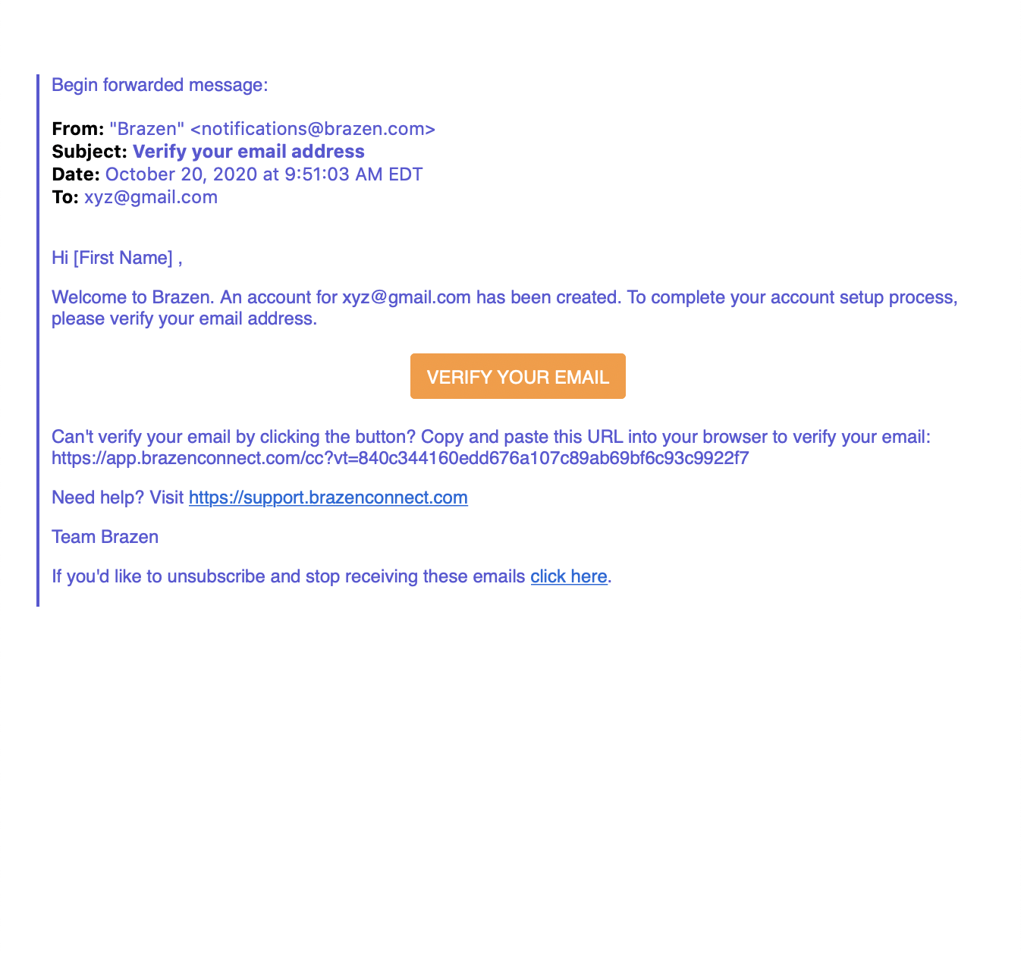
Part 1: Creating a Brazen Account
Step 3: Confirm email address
Notes:
You will receive an email from Brazen requesting you to verify your email account.

Slide 8
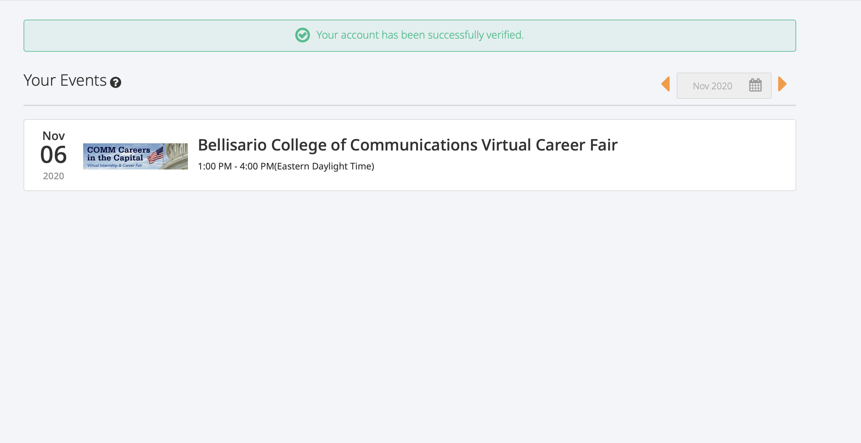
Part 1: Creating a Brazen Account
Step 4: Save event confirmation
Notes:
Once you have confirmed your email address you will receive verification and see Bellisario College of Communications Virtual Career Fair as one of Your Events.

Slide 9
Attending an event
How do I participate in a live event?
Notes:
Coaching students on waiting in a chat line (6 max)and when the event ends; students will be 'kicked-off' and not have that interaction.
We encourage students to get into your top choices first- reverse what we normally recommend at live events
Students engaged in chats when the event ends will be able to complete those chats.
Consider "Drop off Notes" to employers before the event ends as a way to express interest and for employers to follow up after the event.

Slide 10
Part 2: Entering the Event
Step 1 : Navigate to event landing page
https://app.brazenconnect.com/a/Comm/e/4LYKm
Click login at top right
Notes:
Live URL - https://app.brazenconnect.com/a/Comm/e/4LYKm
Login at the top right.

Slide 11
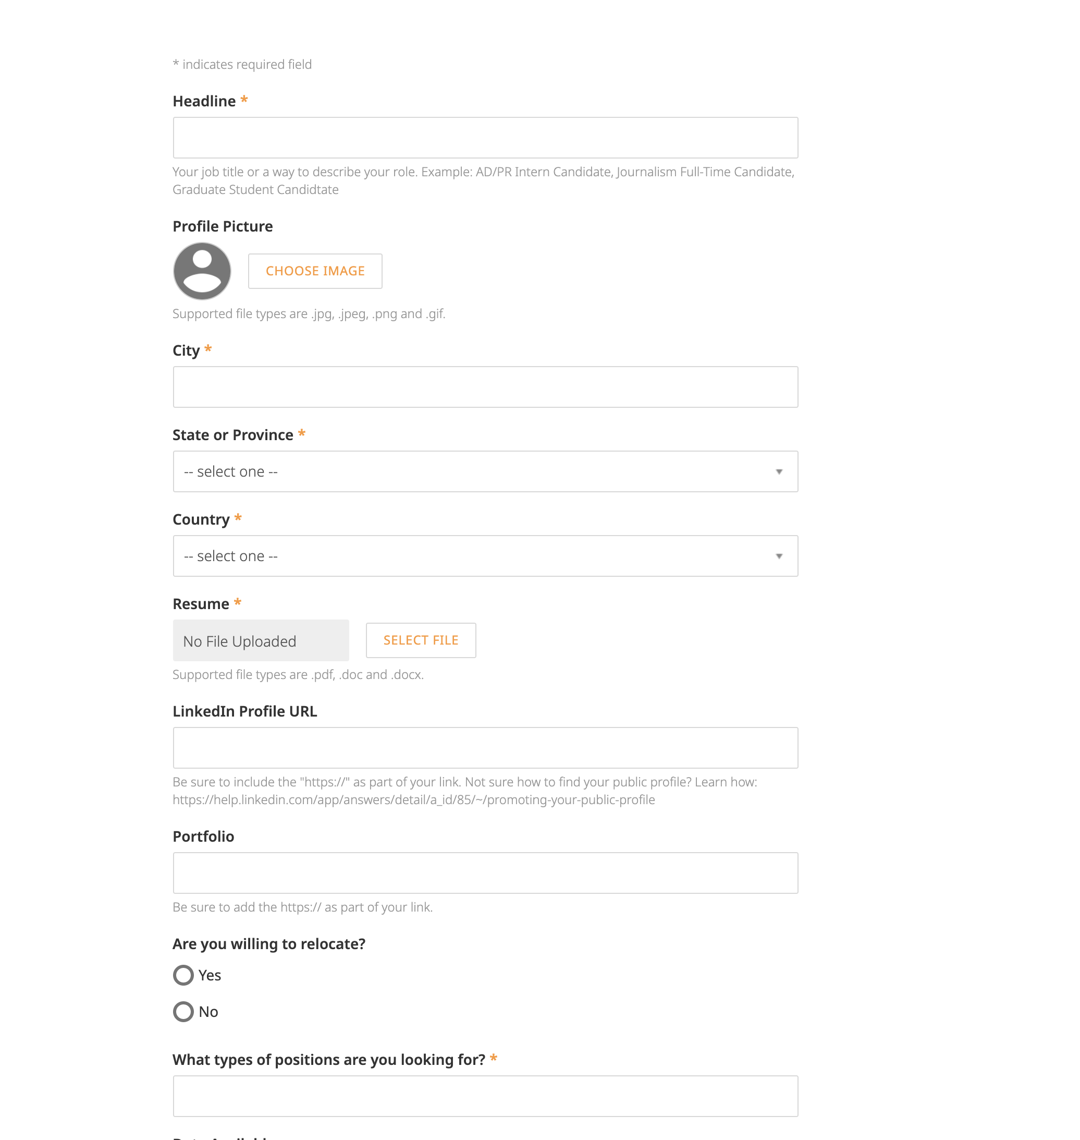
Part 2: Entering the Event
Step 2 : Complete your Event Registration Form
Notes:
Enter the requested information in the event registration form and click "Continue" when you are done.
Registration forms are always unique to an event and you will be required to fill one out for every event you attend.
These forms compile information for your personal profile during an event.
Complete these forms thoughtfully- they should align closely with your resume (ex. FCD student)- make sure graduation year is College, major aligns with resume, etc.
CAN DO AHEAD OF TIME- BEST PRACTICE TO DO THIS!

Slide 12
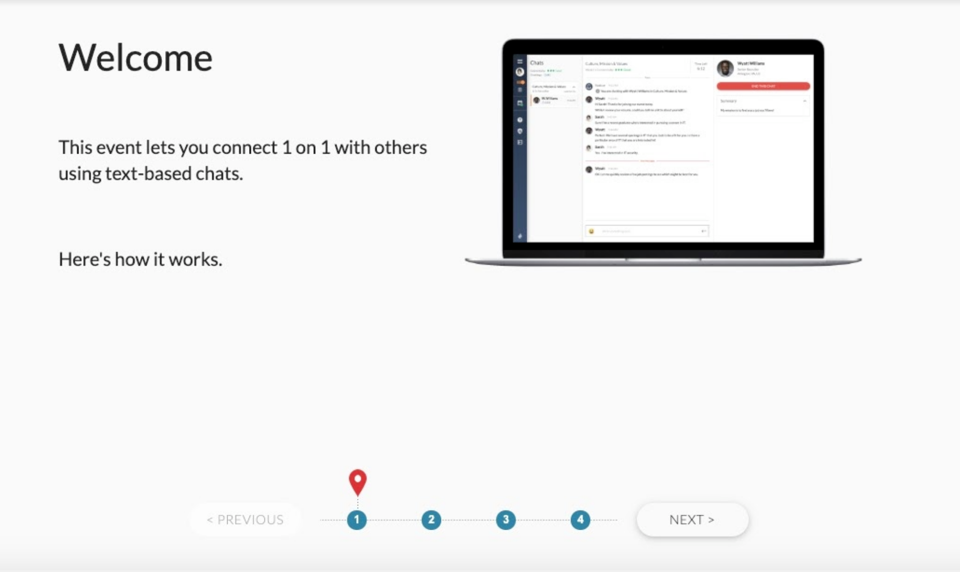
Part 2: Entering the Event
Step 3: Enter the live event
Notes:
You will see a welcome window where you can click through some slides of how online events are run, and at the end you’ll see a button labeled "Enter Event.” This will bring you to the lobby

Slide 13
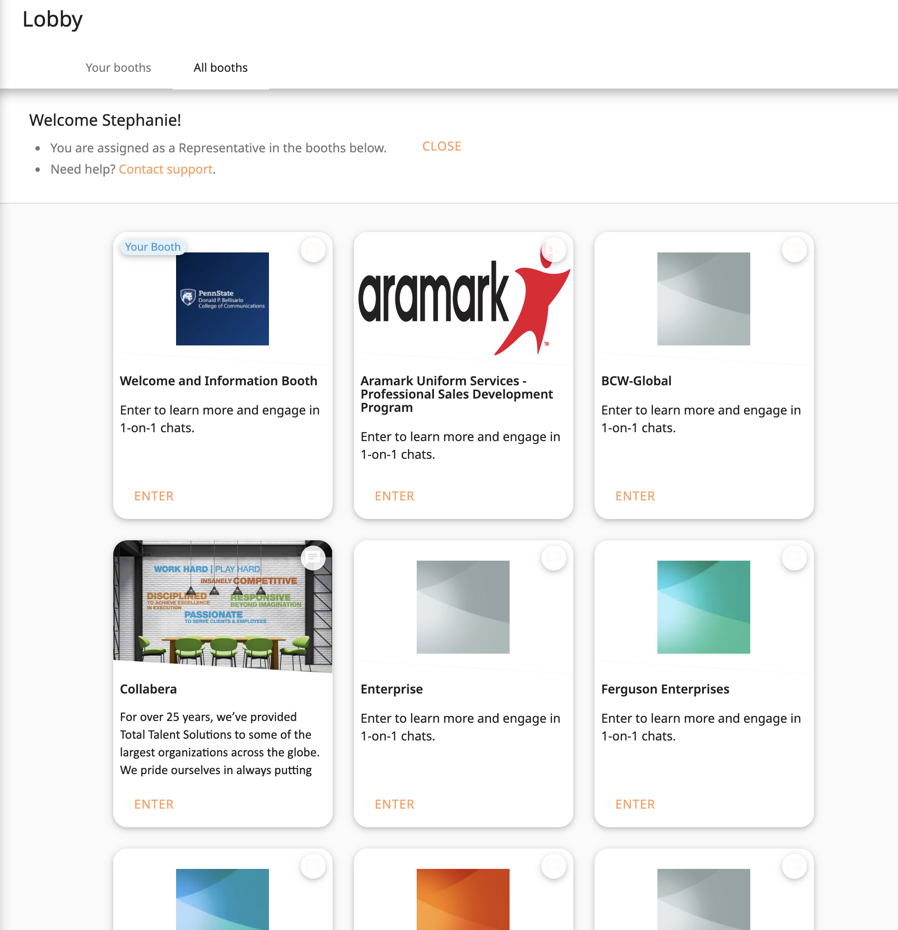
Part 3: Participating in the Event
Step 1: Scan the Event Lobby for booths you want to chat in
Notes:
In the Event Lobby you will see a number of booths labeled with the organizations who are staffing those booths. Scan through them and decide which booths you want to visit.
Understand that a recruiter may ask you to phone or video chat; be prepared and ensure that you are professional. Note: If a recruiter doesn't engage you via video, it's not necessarily a bad thing. Not all employers will use this feature. * You can also be proactive and ask the recruiter to move your chat to video.
Note: You can get in line to chat in multiple booths during the event. Just repeat steps 3-4 below for each booth you are interested in. You will not miss an opportunity if you are in multiple lines while you are engaged in other chats. Your place in line will be saved when you entered that booth. The employer will see that you are engaged and move to the next student in their line. Once they are completed and see that you are available, they will engage you.
You will be able to get into up to 6 chat lines, but be aware this may affect your ability to chat with your a-list employers.

Slide 14
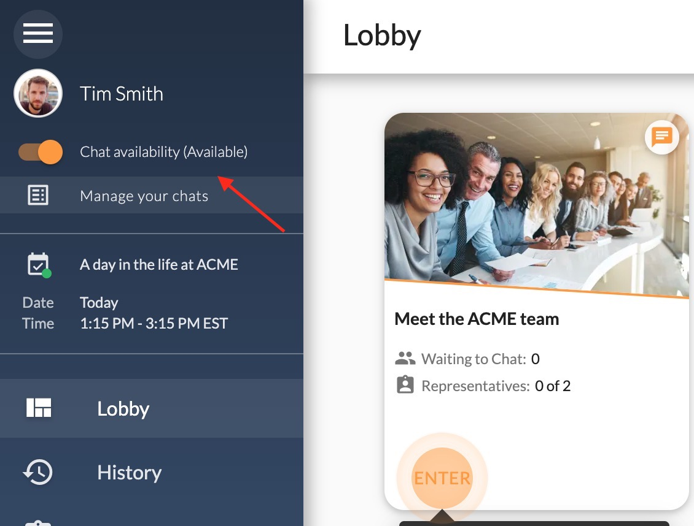
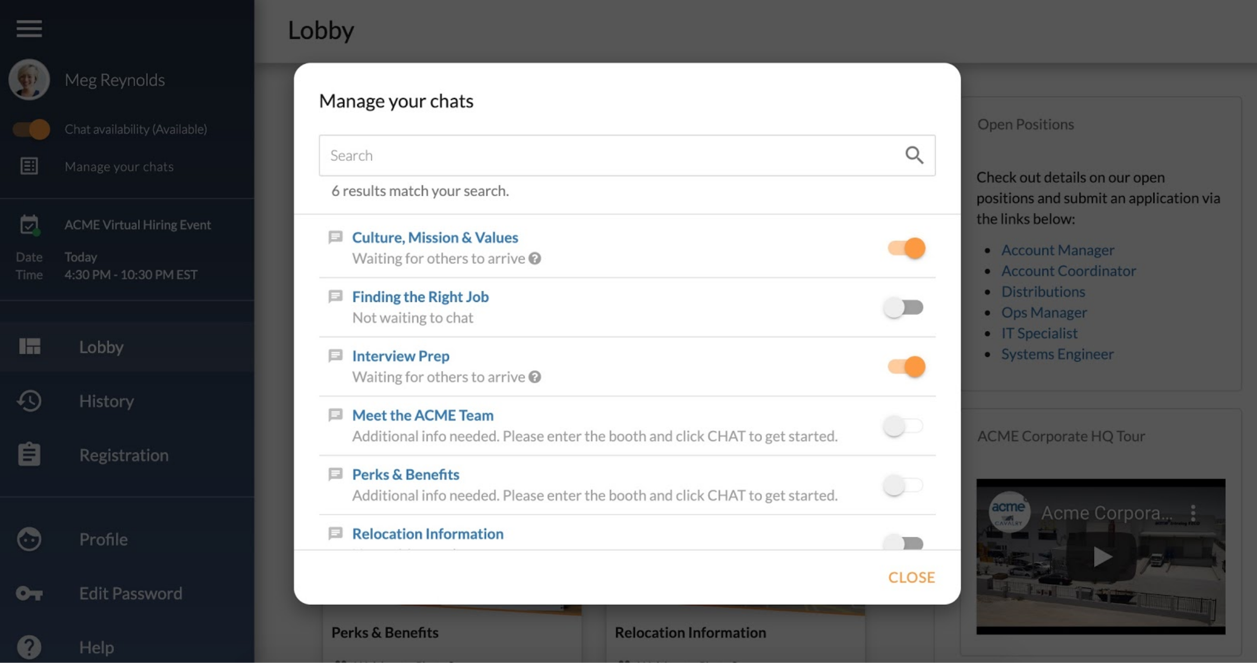
Part 3: Participating in the Event
Step 2: Manage your chats
Notes:
When you enter the event, your chat availability is automatically set to “available” when the event begins. However, in order to accept chats, you must still get in line in a specific booth of your choice. You may toggle your status to “Away” at any time during the event to stop receiving chats from any booths you may be in line for.
There are two ways to get in line to start chatting in a booth:
Manage your chats icon
Entering individual booths and clicking the green chat button
You may get “in line” with as many as six companies at one time
Note: If you are in line for chats and you set your status to "Away," your place in line will be held for you.

Slide 15
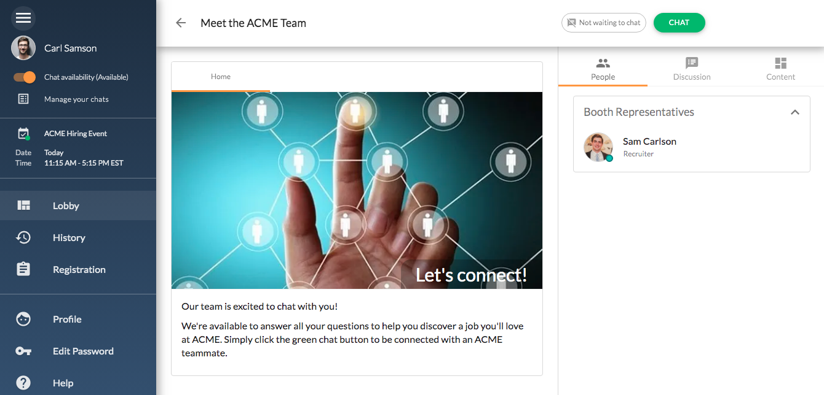
Part 3: Participating in the Event
Step 3: Enter a booth
Notes:
Click the "Enter" button on a booth you are interested in, and you will be taken to that booth’s screen.

Slide 16
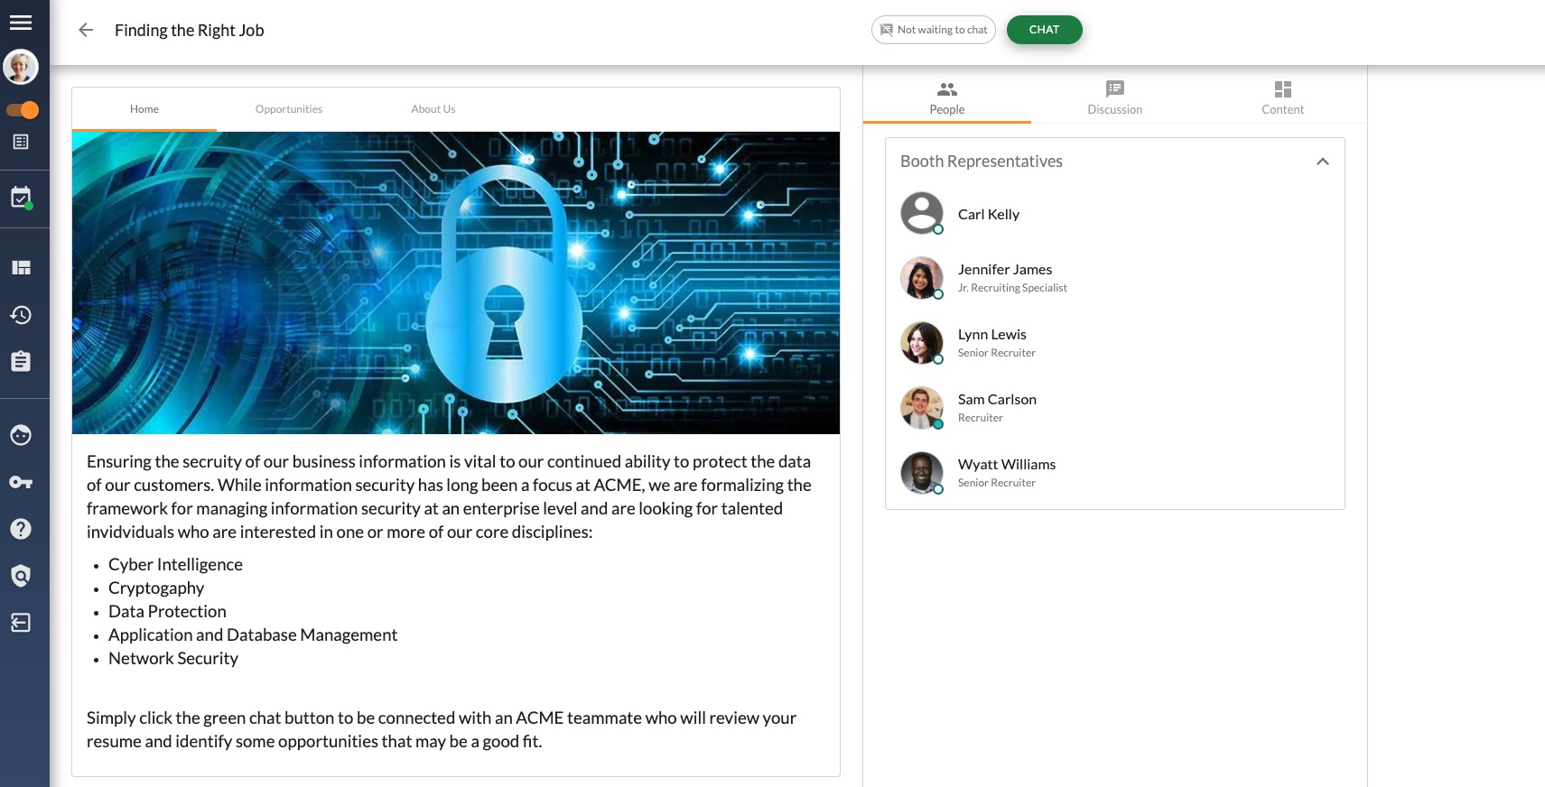
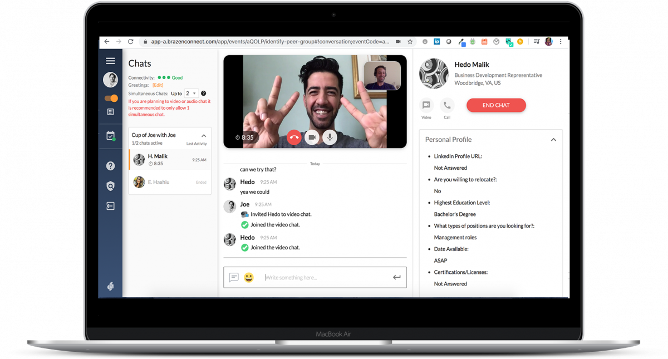
Part 3: Participating in the Event
Step 4: Click to chat
Notes:
Click the green "Chat" button at the upper right to indicate you are interested in chatting with a representative staffing this booth.
Some booths will require you to specify an opportunity of interest before entering the chat line. You will need to click the opportunity that makes the most sense for you.
Next, you will be required to answer a few questions about the opportunity you specified. These questions will help the booth representatives prepare for your chat.
Note: You may not be actively seeking and internship or employment currently, but are interested in expanding your network or learning more. Indicate that to a recruiter and engage to get their contact information.
Note: The recruiter may initiate a video chat; be prepared by dressing professionally with a neutral background

Slide 17
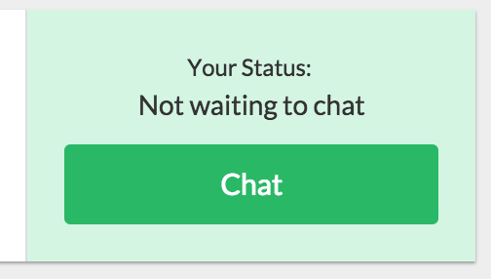
Part 3: Participating in the Event
Step 5: Start chatting
Notes:
Make sure your volume is on and loud enough- You will hear an audible "ping" notification when it is your turn to chat with a representative, and will be automatically taken to the chat screen.
Note: Please make sure to respond to the chat invitation promptly, as the chat will time out if the invitation is not accepted in a timely manner.
You will chat directly with a representative while on this page.
Note: It is important to keep an eye on your chat connectivity and the time left in your conversation. Bad connectivity could affect your ability to chat.
If you are waiting in a chat line and the event ends; students will be 'kicked-off' and not have that interaction. Students already engaged in a chat when the event ends will be able to complete those chats.
Note: You should consider "drop off notes" to employers before the event ends as a way to express interest and for employers to follow up after the event.

Slide 18
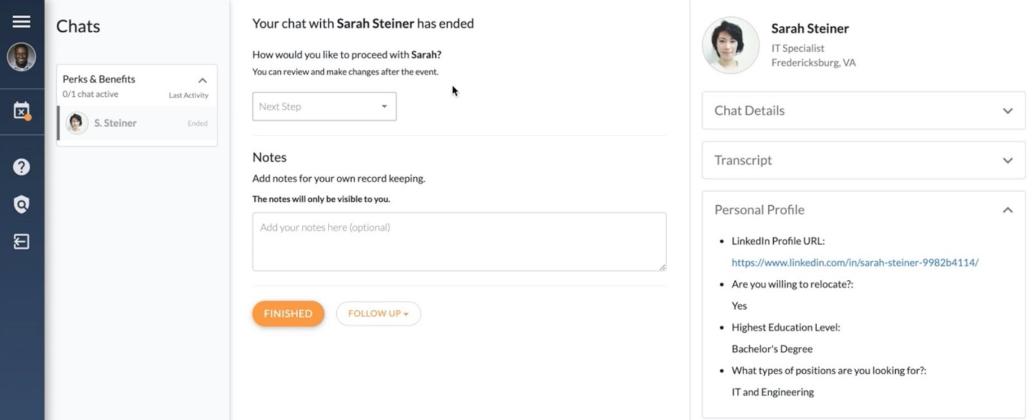
Part 3: Participating in the Event
Step 6: Rate and take notes
Notes:
You will be taken to a chat conclusion page when your conversation has ended. This page will allow you to rate your chat and take notes about the representative or anything that was discussed. When you are done, click the "Continue with Event" button to return to the Event Lobby. Employers will not be able to see your ratings, but they will be able to access chat history. That's why it is important to be professional at all times!
You can access your chat history for at least 6 months by clicking "History" in the upper right hand corner of your screen from the lobby. To access the lobby after the event, enter the event just as you would if it were live.
Note: It's important to add notes and rate your chat, especially if you participate in more than one conversation.

Slide 19
Event FAQs
support@brazen.com
Attending an event: Link
Joining Video/Audio Chat: Link
How do I upload/change my resume? Link
How do I change/add my resume after I register? Link
Sending and Receiving "Final Thoughts”: Link
How can I select the correct time zone for display on my profile? Link
How to Change My Password: Link
Brazen Service Check - use this link to check if everything within your computer/browser is compatible with Brazen

Slide 20
Technical FAQs
support@brazen.com
Accessibility Guide
Verify my account email address
Password Reset
How do I test my internet connection?
How do I test my sound?
How do I delete my browser cookies?
Is the site 508 compliant?
How do I upload/change my profile picture after I have already registered?
Is my browser supported?
Can I access events using a mobile device or tablet?
Is the event platform compatible with screen readers?

Slide 21
Troubleshooting
support@brazen.com
Why am I not in a chat yet?
Brazen Application Emails and Spam Filters
I'm not being connected to chat
I've reached an error page. How do I get back to my event?
My chat suddenly ended, what happened?

Slide 22
Final Thoughts
1. Research, Research, Research
2. Script Responses
3. Watch the clock
4. Get Contact Info
5. Save Materials
6. Keep it Professional
Notes:
1. Just as you would an in-person fair, make sure that you research the organizations that you plan on interacting with- don't go to a booth and say, "Tell me about your company, or What does your company do?" You should have an understanding of that already.
2. Especially for chat, have your responses canned and saved in a document to save time typing; simply copy/paste. This is true of your resume and elevator pitch as well.
3. Most interactions are timed. In addition, even if you are in line, if the event ends, you will not have an opportunity to interact. (For example, if you are waiting in a chat line and the event ends; you will not have the opportunity to chat.)
4. Get the contact information of the individual(s) that you interact with and make sure that you follow up with them. Include a thank you note, any asks of them, and any additional questions you may have, including next steps.
5. Save all your materials, including a transcript of your chats. After each interaction, keep notes of your conversations for review after the virtual fair.
6. Keep it professional at all times. It may be easy to "text speak" since you are in a chat. Be prepared for a video call. Wear professional attire and mind your posture.

Slide 23
questions

Slide 24
we are here for you
Notes:
Contact our office for assistance. We can assist you through every step of the process.

