Slide 1
Poster Printing Guidelines for Graduate Students

Slide 2
Graduate Funding Request:
All students will be required to submit a Graduate Funding Request form for poster printing BEFORE submitting the poster for printing.
When approved, a charge number to use will be provided.
This number will be provided to the Multi Media Center for payment.

Slide 3

Poster printing is part of the online ordering system. The link is:
Very Important:
You will need to access from a secure on campus connection or from Global Protect – the site is a Secure University Authentication connection.
https://www.psuprints.psu.edu/fulfillment/

Slide 4
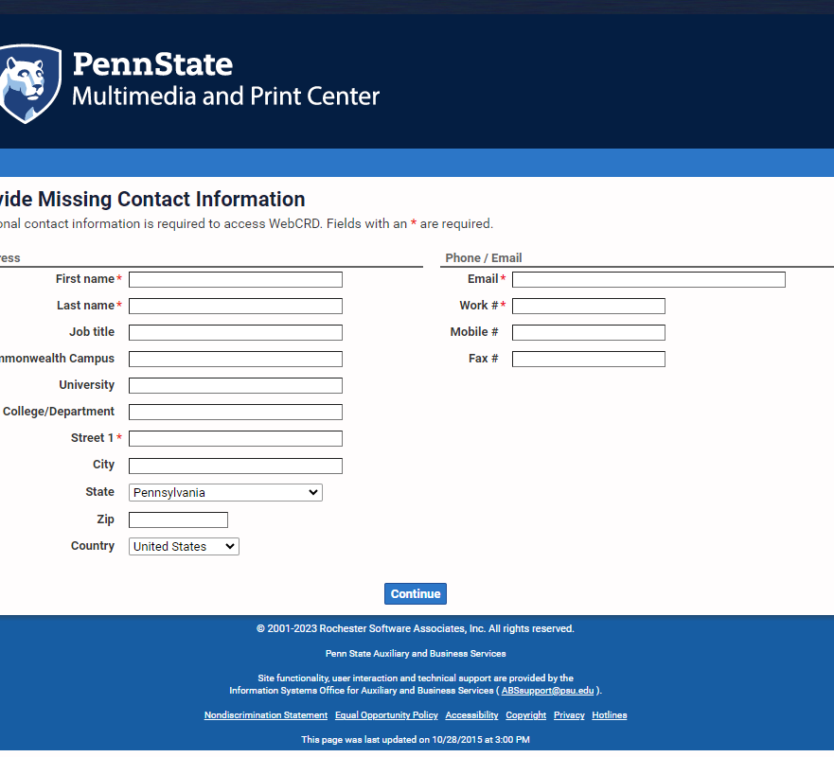
Sign in:
If you have not registered with the Multimedia and Print Center, you will be directed to.

Slide 5
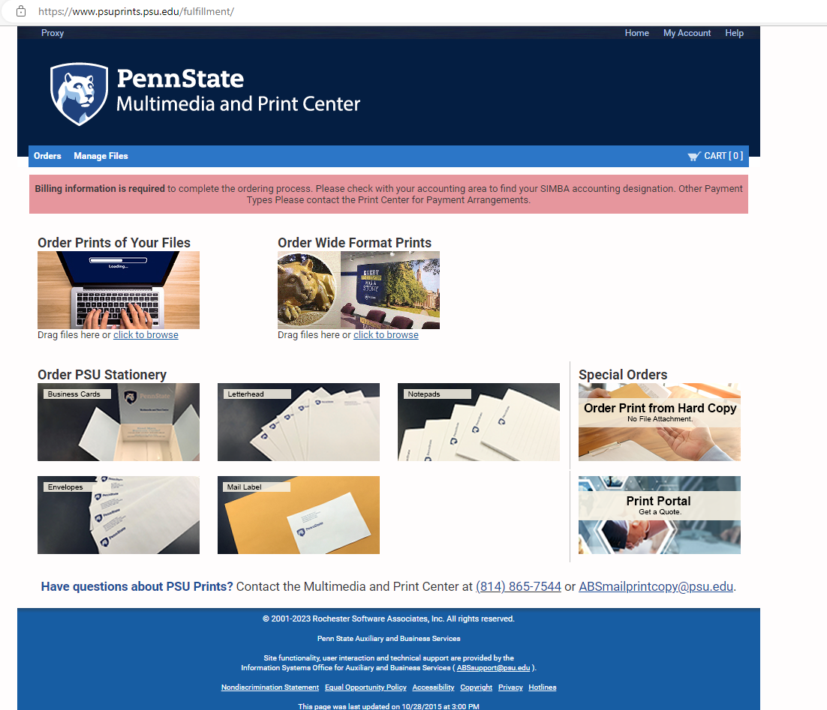
Use the “Order Wideformat” Icon on the ordering home page.
Attach .pdf file
Choose material
Choose finishing options – if applicable
Note final output size in notes

Slide 6
Billing:
If paying with a credit card:
Enter: Ten Zeros in the account field (as noted on the screen)
If paying with an internal charge number, please use the internal order number provided to you the Graduate Program Coordinator.
Permission is required each time a poster is requested.
**It is recommended files be submitted 48 hours prior to pick-up.

